Slide 1
Identifiers and Keywords

Slide 2
Identifiers
In C# and identifier is a name given to a varaible, constant or any user defined programming element
An identifier starts with a letter or underscore and ends with character
C# identifiers are case sensitive.
Microsoft suggests the naming convention Hungarian and Camelcasing notations.

Slide 3
Rules
An identifier must begin with a letter or underscore.
Must not be the reserved words.
Should not start with digits.
An identifier must be complete words without blank spaces

Slide 4
Keywords
Are the reserved words whose meaning are predefined to C# compiler.
Reserved by c# compiler to be used for specific task.
Cannot be used as varaibles , methods,and properties because they are defined to the compiler to perform specific task

Slide 5
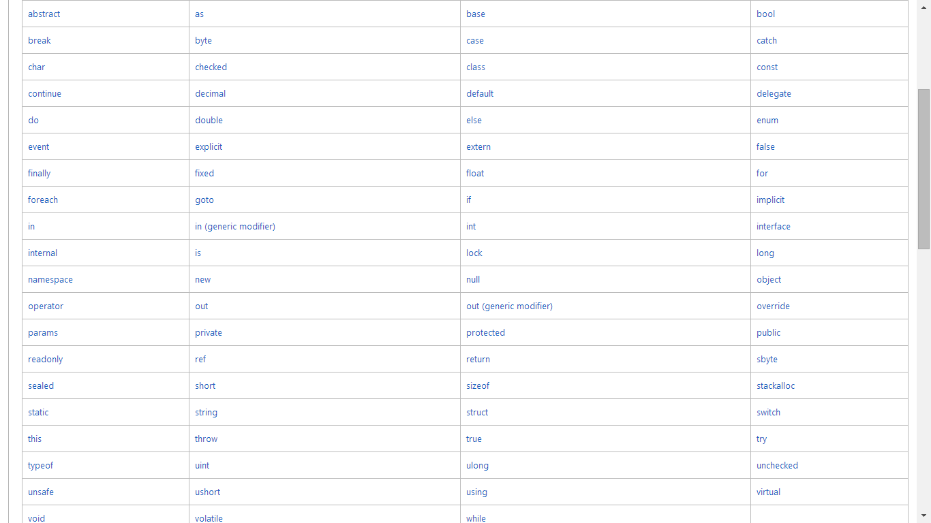

Slide 6
Keywords
What is Contextual Keywords ??
What is difference between Reserved and Contextual Keywords?

